Slide 1
Data Lake

Slide 2
Index
What is a Data Lake?
Data Lake vs Data warehouse
Gotcha of Data Lake
ETL vs ELT
Cloud provider Data Lake

Slide 3
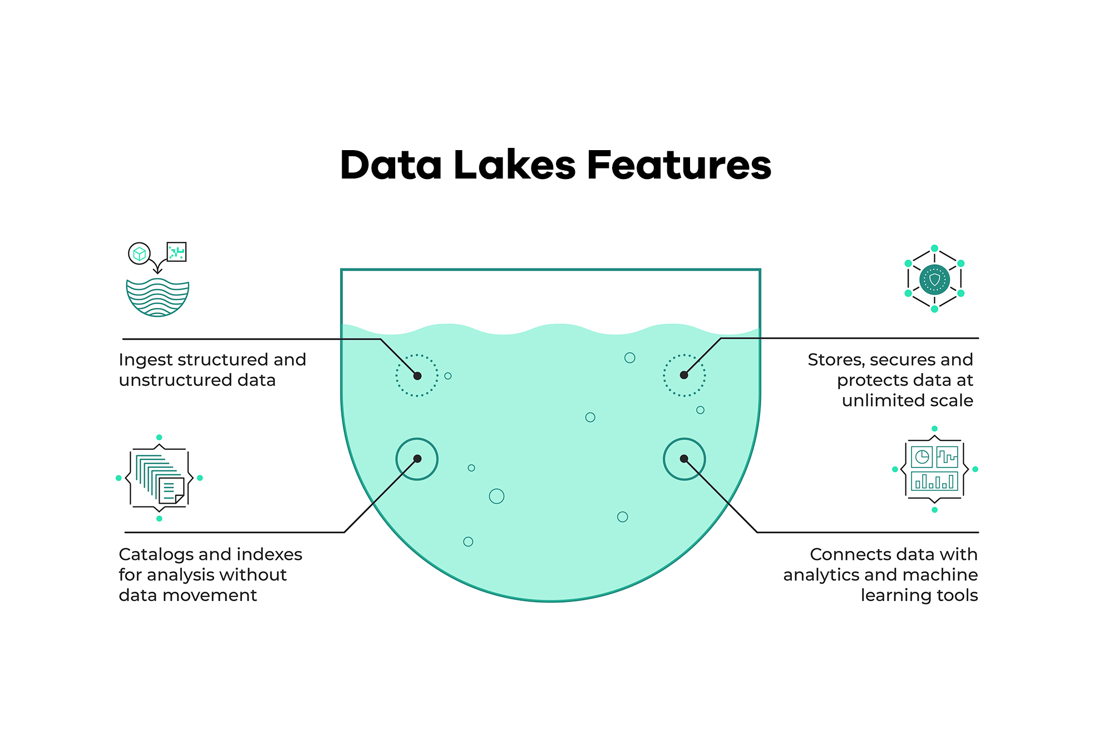
Data Lake is?

Slide 4
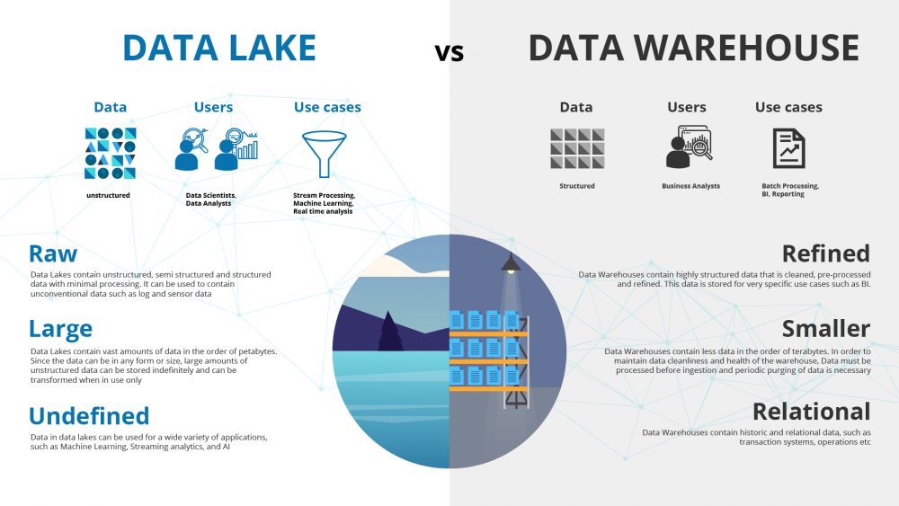

Slide 5
How did it start?
Companies realized the value of data
Store and access data quickly
Cannot always define structure of data
Usefulness of data being realized later in the project lifecycle
Increase in data scientists
R&D on data products
Need for Cheap storage of Big data

Slide 6
ETL vs ELT
Extract Transform and Load vs Extract Load and Transform
ETL is mainly used for a small amount of data whereas ELT is used for large amounts of data
ELT provides data lake support (Schema on read)

Slide 7
Gotcha of Data Lake
Converting into Data Swamp
No versioning
Incompatible schemas for same data without versioning
No metadata associated
Joins not possible

Slide 8
Cloud provider for data lake
GCP - cloud storage
AWS - S3
AZURE - AZURE BLOB

